Slide 1




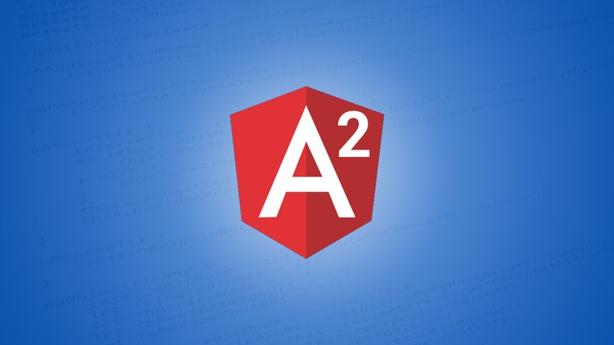

JQuery and Angular 2 side by side analysis
Vivek Siruvuri – Lead Consultant (UI/UX )– JavaScript Developer , Raspberry Pi enthusiast
GitHub – www.github.com/svivekvarma
Twitter – www.twitter.com/svivekvarma

Slide 2

Target Audience for this presentation
Been a server side coder and trying to figure your way in the jungle of JS frameworks ?
Are you a ASP.Net MVC developer with some JQuery experience ?
Have you been a JQuery developer and now figuring if Angular2 could be a good move ?
Are you a manager trying to figure out the pros / cons and compare JQuery to Angular2 ?
Have you been oversold with two way binding and figuring out what you might miss ?
You have never heard about JQuery Widget factory
Trying to understand Cost overhead / Time overhead with JQuery / Angular2

Slide 3
Why Frameworks
What , why would I need a framework ?

Slide 4
What constitutes a Frameworks
Namespacing
Modularization
Routing
Templating
Data Binding
Animation Engine / Richer UI
Testing platform

Slide 5
So how do we solve it
Namespacing / Modularization
IIFE
Modules – AMD
Modules – CJS

Slide 6
So how do we solve it
Routing
Hash based #todo or #todolist
History API DEMO

Slide 7

So how do we solve it
Templating / Data binding
Mustache / Underscore/ Handlebars
Databinding

Slide 8
So something put together with
Namespacing
Modularization
Routing
Templating
Data Binding
Now Constitutes a framework

Slide 9
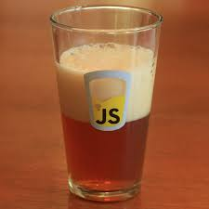
Cheers !!!
So now what ??

Slide 10
Let’s compare
RequireJS / JQuery / AMD / Open Road Map
Angular 2

Slide 11
RequireJS/ JQuery
Walkthrough of the project files and structure

Slide 12
RequireJS/ JQuery
Namespacing
Modularization
Routing
Templating
Data Binding

Slide 13
RequireJS/ JQuery
Demo/ Walkthrough

Slide 14
Angular 2
Namespacing
Modularization
Routing
Templating
Data Binding

Slide 15
Angular 2
Demo/ Walkthrough

